Slide 1

Swift Visa: AI-Based UK Visa Eligibility Screening Agent Internship Project Technology: AI| Python| Stream lit
Presented by: V. Kiran Kumar Reddy

Slide 2

PROBLEM STATEMENT
UK visa eligibility rules are complex and difficult for applicants to interpret correctly.
Official visa policy information is lengthy and not easily accessible for quick eligibility checks.
Manual evaluation of visa eligibility is time-consuming and prone to human error.
Eligibility requirements vary across different visa categories, increasing confusion for applicants.
There is no policy-driven system that provides transparent and structured eligibility feedback before application submission.

Slide 3

EXISTING SYSTEM
Applicants manually check UK visa eligibility using official websites and policy PDFs
Heavy dependency on visa consultants and agents
Eligibility verification is time-consuming and complex
Manual interpretation often leads to errors and confusion
No instant or automated eligibility confirmation

Slide 4
PROPOSED SYSTEM
Swift Visa is an AI-based visa eligibility screening system
It evaluates applicant information against official UK visa policy documents
The system provides a clear eligibility outcome with supporting reasons
Policy rules are sourced directly from PDF documents
The solution is designed to be transparent, structured, and user-friendly

Slide 5

KEY TECHNOLOGIES
Python – Core programming language for application logic
Stream lit – Web framework for building the interactive user interface
Groq API (LLaMA Models) – AI-based eligibility reasoning engine
PyPDF2 – Extraction of eligibility rules from UK visa policy PDFs
HTML & CSS – Custom styling for a professional UI.
Retrieval-Augmented Generation (RAG) – Combines vector search results with AI reasoning for accurate decisions.

Slide 6

Supported Visa
Student Visa – For international students enrolling in full-time courses at licensed UK education providers.
Graduate Visa – For students who have completed a UK degree and wish to stay and work in the UK.
Skilled Worker Visa – For professionals with a confirmed job offer from a licensed UK employer.
HealthCare Visa-For qualified healthcare professionals offered eligible roles in the UK health and care sector.
Visitor Visa – For short-term visits to the UK for tourism, business, or visiting family and friends

Slide 7
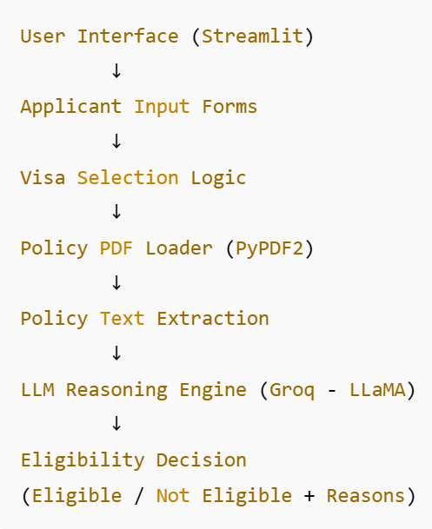
SYSTEM ARCHITECTURE
Swift Visa follows a layered and modular architecture for visa eligibility screening
A Stream lit based user interface collects applicant details and visa type
Input data is validated and structured based on visa-specific requirements
Official UK visa policy PDF documents are loaded and parsed
Eligibility rules are extracted and organized from policy documents
Applicant data and policy rules are processed by an AI reasoning engine (LLM)
The system evaluates eligibility and generates explainable decisions
Final output displays Eligible / Not Eligible status with clear justification

Slide 8
CORE FEATURES
Policy-driven eligibility evaluation based on official UK visa rules.
AI-based reasoning engine for accurate decision making.
Explainable eligibility results with clear reasons.
Supports multiple visa categories with custom rules.
User-friendly and professional interface.
Instant eligibility feedback.

Slide 9

CHALLENGES & SOLUTIONS
Large Policy PDF Documents → Implemented PDF chunking and structured extraction for efficient processing.
Multiple Visa Rules & Conditions → Designed visa-specific eligibility entities for accurate evaluation.
API Key Security Risks → Secured keys using environment variables instead of hardcoding.
GitHub File Size Limitations → Performed optimized uploads and excluded unnecessary files.

Slide 10
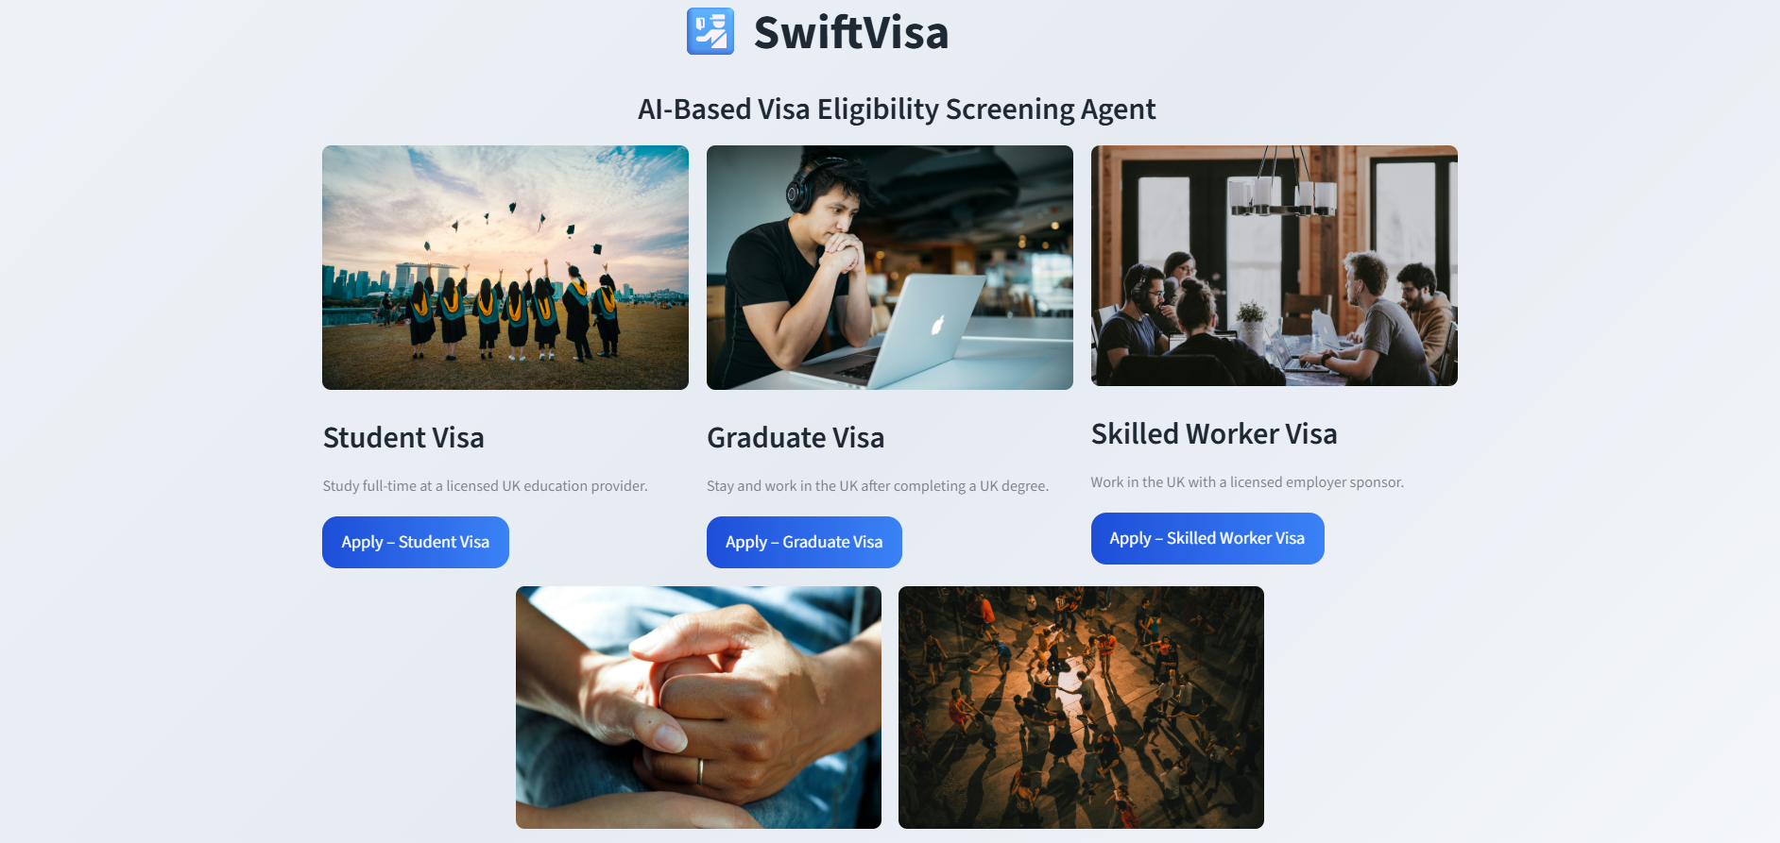
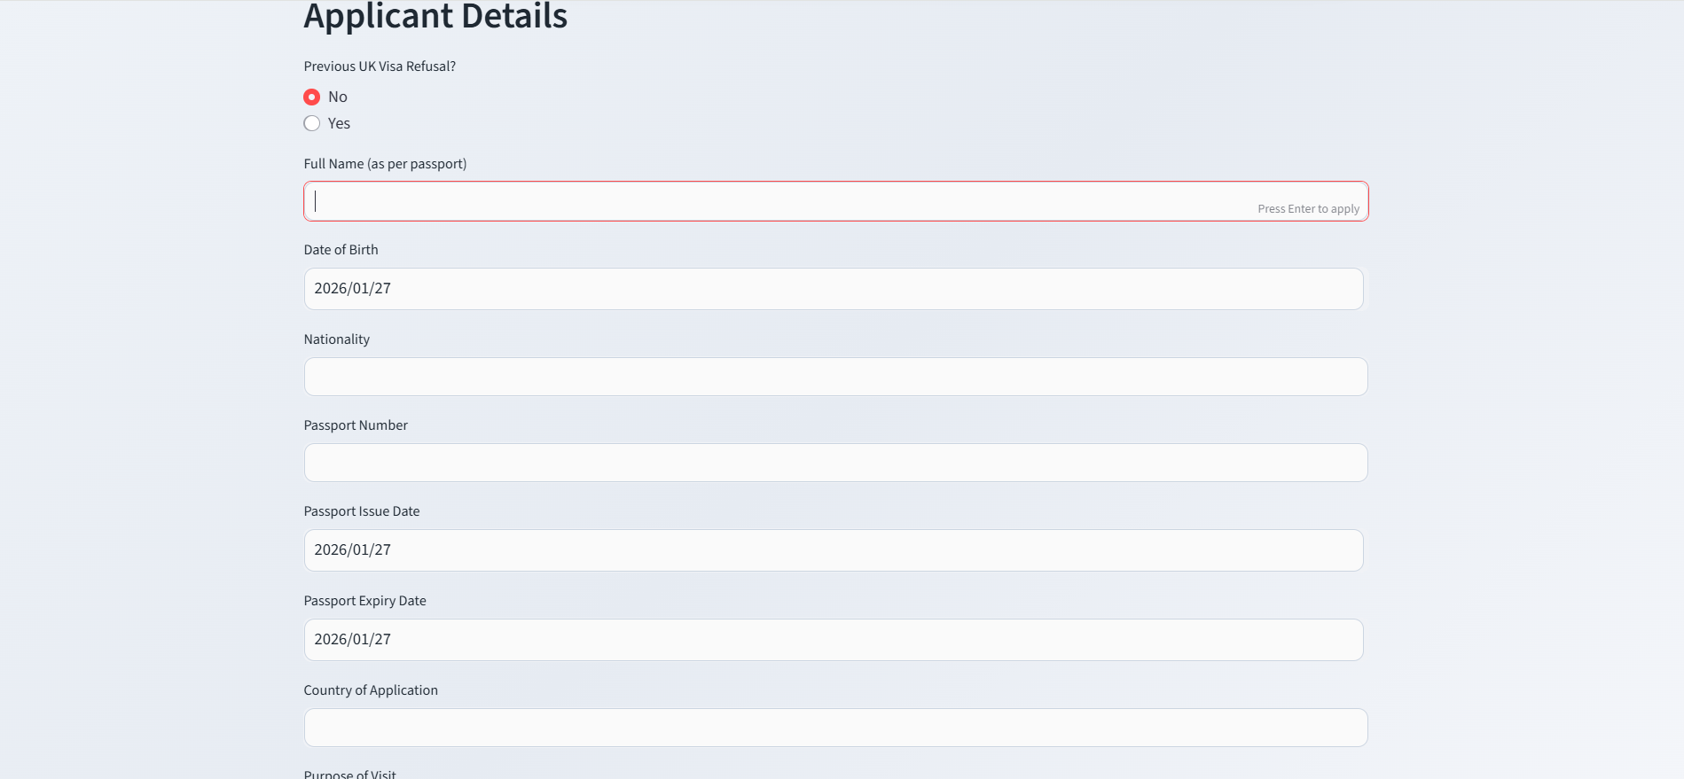
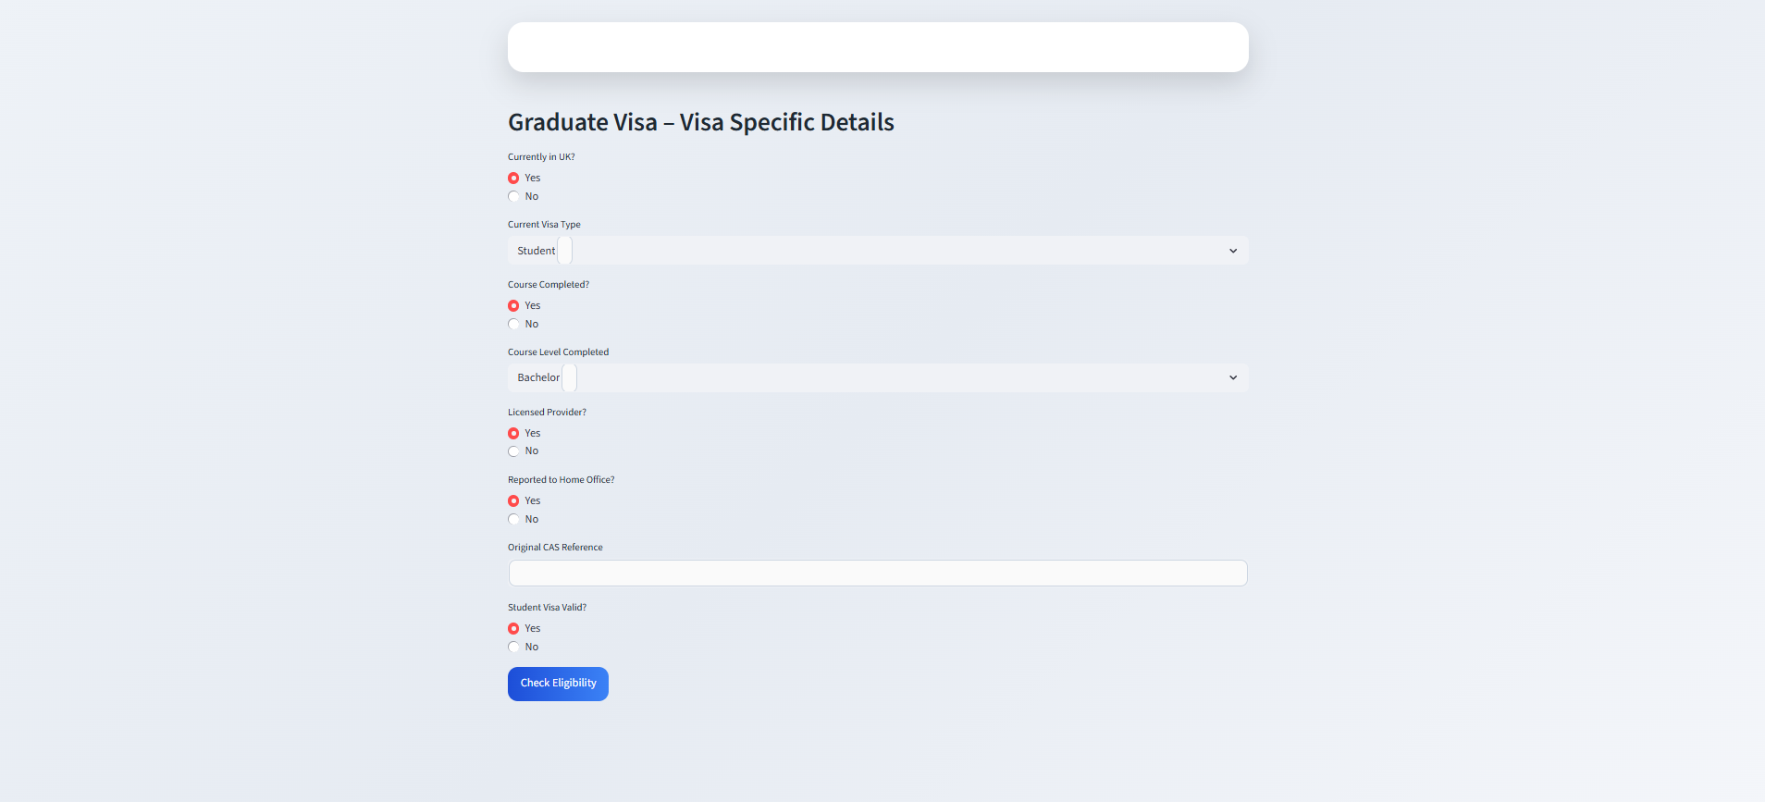
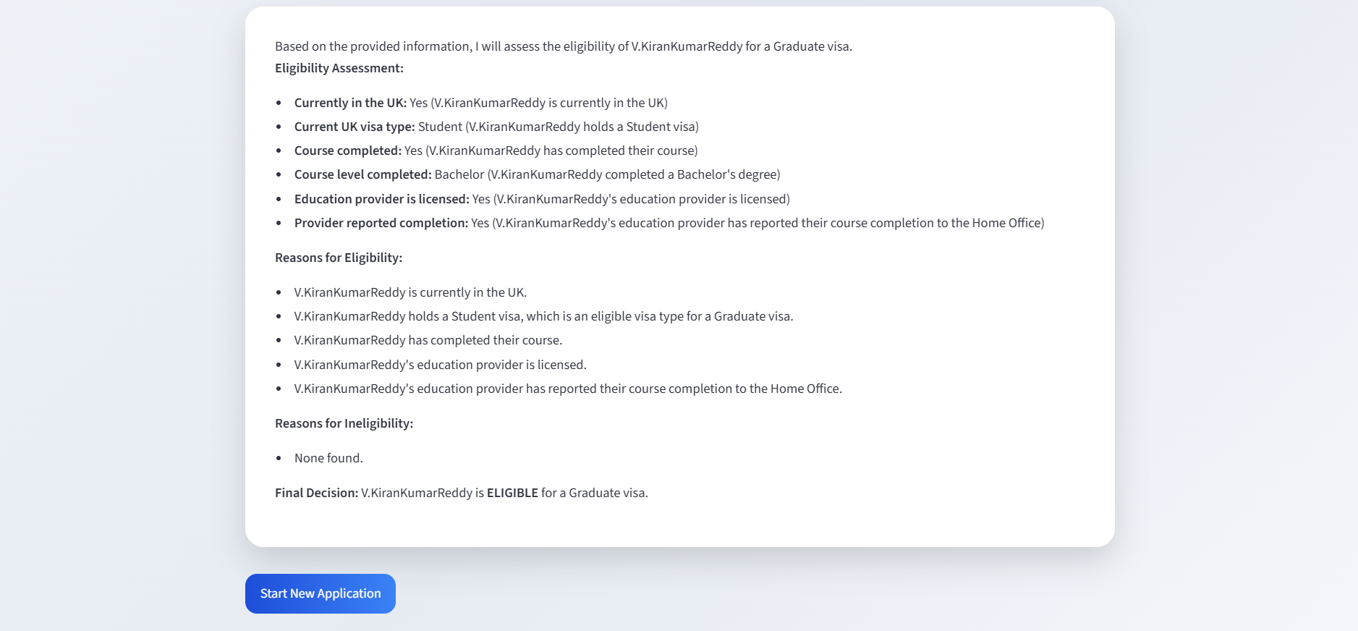
OUTPUT

Slide 11
RESULT & OUTCOMES
Eligibility checking time reduced from hours to seconds.
Improved accuracy using policy-based AI reasoning
Simple and intuitive interface for non-technical users
Eliminates manual interpretation of visa rules
Reliable and consistent eligibility decisions

Slide 12

CONCLUSION
Swift Visa provides an AI-driven solution for UK visa eligibility screening.
Simplifies complex visa rules into clear, explainable decisions
Reduces manual effort and eligibility checking time.
Ensures accuracy using official policy-based reasoning
Designed to be scalable, secure, and user-friendly

Slide 13

THANK YOU

